Slide 1
DIGITAL STUDENT PORTFOLIO
Members:
Angcahan, Limuel Jay R. Jumawan, jovan jay
Aleser, peji cyrus Masong, Michael james
Barbeho, Randolh b. Vistal, carlos fidel

Slide 2
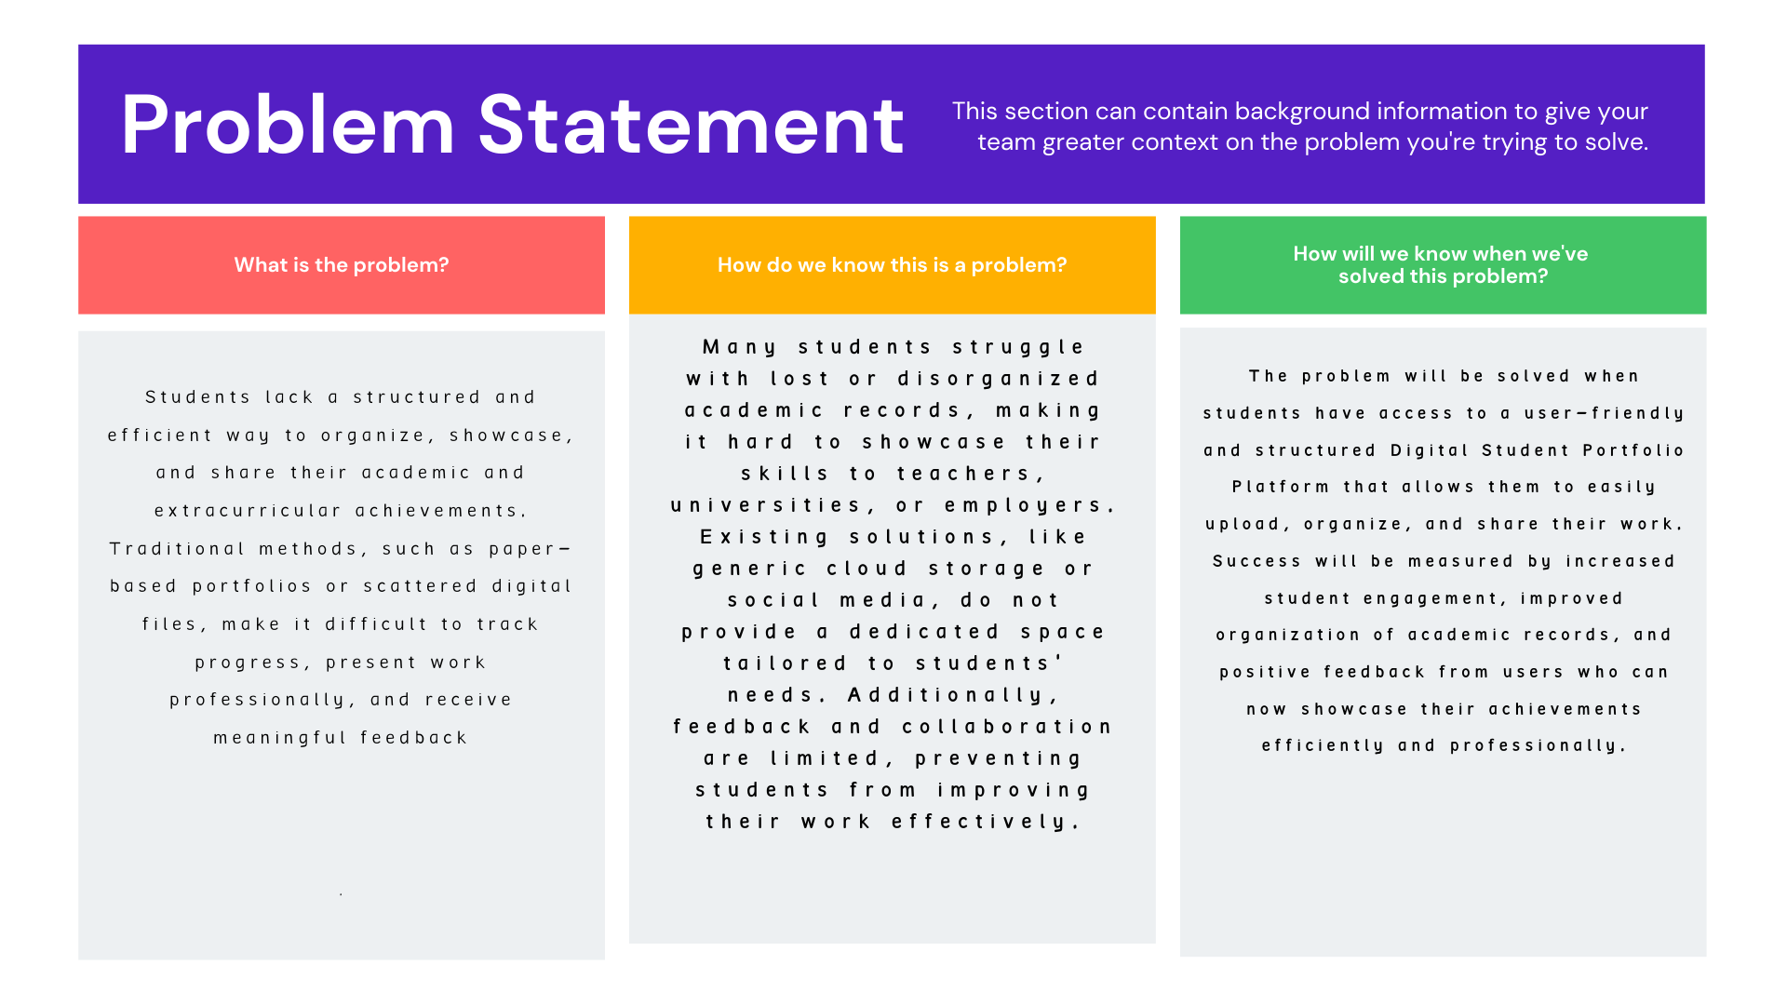
Pain Points/PROBLEM STATEMENT

Slide 3
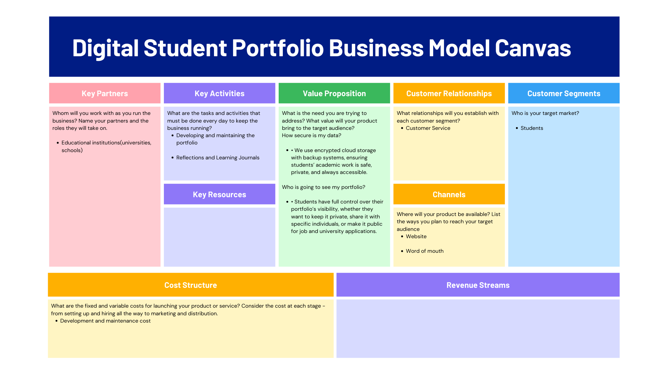
BUSINESS MODEL CANVASS (BMC)

Slide 4
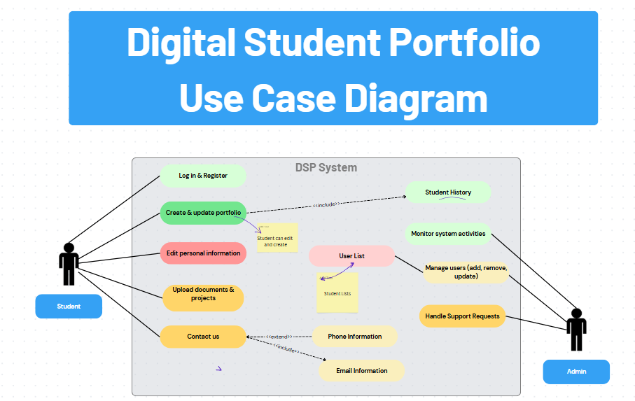
USE-CASE DIAGRAM

Slide 5
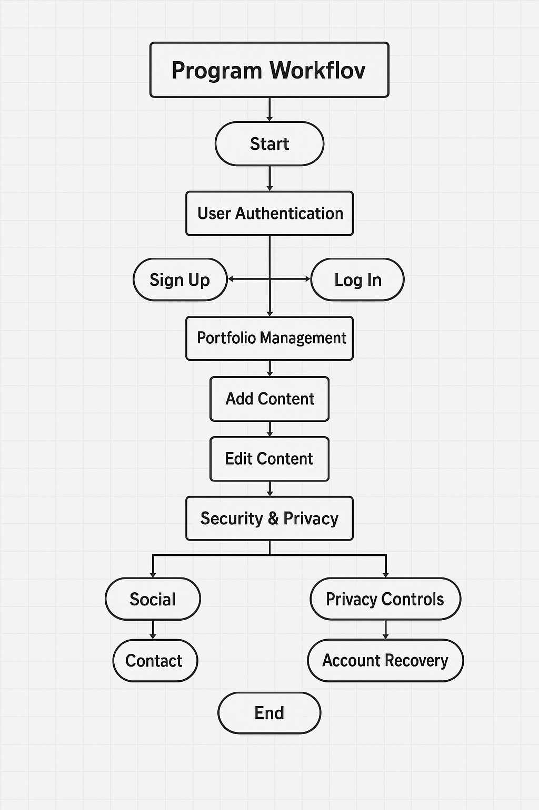
PROGRAM WORK-FLOW

Slide 6
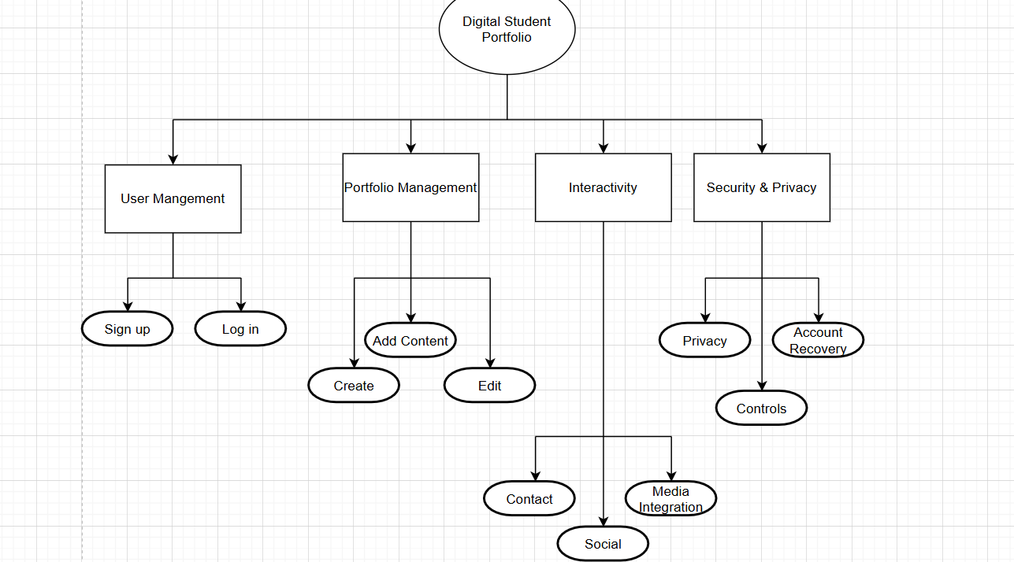
FUNCTIONAL DECOMPOSITION DIAGRAM

Slide 7
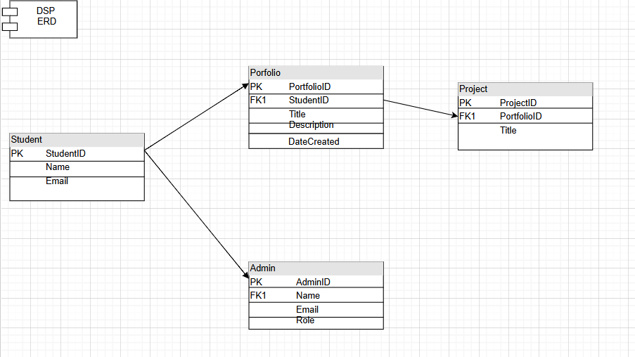
ENITY-RELATIONSHIP DIAGRAM

Slide 8

PITCH VIDEO/EXPLANIER VIDEO

